Slide 1
SCSIT IV Semester DAtabase
Exc. 3
From Entity to Table
From Relation to Table
Diagram.net modeling

Slide 2
Exc.: Entity or Instance?
Discover what every of the given items is: an entity or an instance?.
Item | Entity/Instance
Car
Marketing
Department
Colgate
Continent
Village Smilevo
2000 m. under the sea
University
Entity
Instance
Entity
Instance
Entity
Instance
Instance
Entity

Slide 3
ER diagram
Student
n
n
enrolls
Study
m
1
Course
Year
Define all entities (and relations)

Slide 4
YEAR: ENTITY and INSTANCES
YEAR
year
Entity
description
ID_year
Instances
YEAR(“I”, 1, “First year undergraduate”)
YEAR(“II”, 2, “Second year undergraduate”)
YEAR(“III”, 3, “Third year undergraduate”)
YEAR(“VI”, 6, “”)

Slide 5
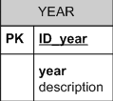
Transferring from entity into Diagram.net Table
Year
year
description
Id_year

Slide 6
1. Entity attributes identification
YEAR
year
Description
Id_year
1. Discover identifiers and composite attributes
2. Break down the composite attributes.
3. Make a list of all entity attributes. Attribute name is with Latin letters and without empty spaces (use “_” instead of “ “)
4. For every attribute write whether it is an identifier or not.

Slide 7
2. Attribute role
Name | Identifier?
year Id_year description | no Yes No
What data type should be inserted in every attribute? Digit, number, letter, word, date, boolean … ?

Slide 8
3. Attribute data types
Data Type | Synonyms | Description
Text(size) Number(size) Datetime … | (N)varchar(50), String(100) Numeric(18), Numeric(9,2) Integer DateTime(8), date/time | Text data Numeric data: Integer, float, number, double, real Date (and time)

Slide 9
Data types for YEAR’s attributes
Name | Identifier | Data type | size
year Id_year Description | No Yes No | Varchar Numeric Varchar | 2 200
IDENTIFIER = PRIMARY KEY
SYNONYMS: Primary Key, PK, *

Slide 10
Required attribute
Can you create a YEAR instance without value for year attribute?
Can you create a YEAR instance without description?
Can you create a YEAR instance without value for id_year attribute?
YEAR(“I”, 1, “First year undergraduate”)
YEAR(“II”, 2, “Second year undergraduate”)
YEAR(“III”, 3, “Third year undergraduate”)
YEAR(“VI”, 6, “”)

Slide 11
4. Required attributes in YEAR
Name | Identifier | Data type | size | required.
year Id_year Description | No Yes No | Varchar Numeric Varchar | 2 200 | YES YES NO
NON-required can have NULL value in some entity instance
SYNONYMS for “required”: mandatory, not allows null, not null

Slide 12
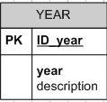
Well done !!!
We’ve created table model for the YEAR entity
Id_year: PK, numeric(9), not null year: varchar(2), not null description: varchar(200)

Slide 13
Ass. 1
Use the table model for the YEAR entity and create entity-table in Diagram.net.
NOTE: The Table name is ONE word written with Latin letters (YEAR, course_student)

Slide 14
Let’s create model for another table
STUDENT
n
n
enrolls
STUDY
m
1
course
YEAR
STUDENT is an entity that is in n-1 relation with YEAR.
What does it mean?

Slide 15
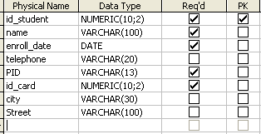
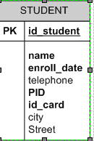
Transferring from entity into Diagram.net Table
student
name
PID
Enroll_date
telephone
Id_student
Address_data
ID_card
street
city

Slide 16
Entity and instances
student
name
PID
Enroll_date
Entity
telephone
Id_student
Address_data
ID_card
street
instances
city
student(“eva“, 10, „2910981452212“,„01/09/2000”, 7948, „078455164“, „St. Jane Sandanski BB“, „Skopje“)
student(“Pero“, 32, „121213113131“,„11/09/2003”, 8910, “ “, “ “, „Skopje“)

Slide 17
Data types, requisiteness and PK for STUDENT’s attributes
NOTE: PID is ALWAYS TEXT data type.
Ex. Text(0205981454401)=0205981454401
Number(0205981454401)=205981454401
(no starting “0” in numbers)

Slide 18
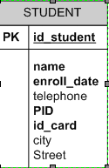
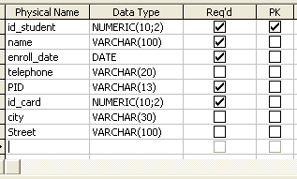

Slide 19

5. What about the n-1 relation? How to represent it?
STUDY
RULE:
Whenever there is an 1-n relation that should be represented (modeled), in Diagram.net you must create RELATION from the entity-table with cardinality 1 to the entity-table with cardinality N
With this, in the second table (with cardinality n), a NEW attribute appears, which represents the primary key of the entity with cardinality 1 (in the relation)

Slide 20
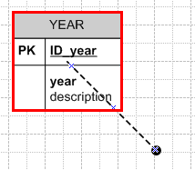
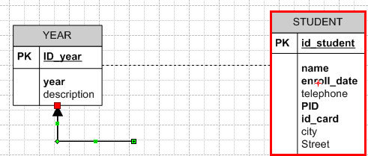
1. Drag and drop relation from YEAR entity-table. You drag until the entity-table border doesn’t become RED
2. Then, drag the relation towards the STUDENT entity-table.
You drag until the entity-table border doesn’t become RED

Slide 21
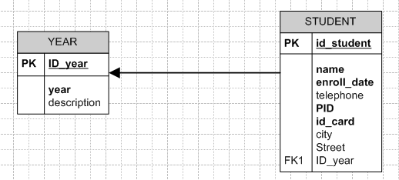
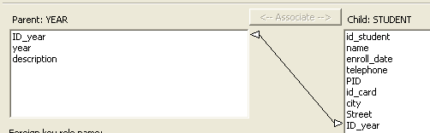
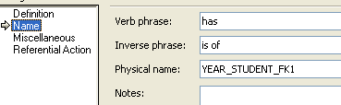
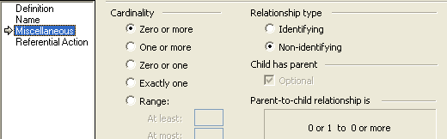
This field was
automatically createdи
Relation overview
Attribute referencing
Name
Cardinality

Slide 22
6. What is the role of the new attribute?
Id_year in Student is NEW attribute, that represents YEAR, i.e. it represents the entity in STUDY relation with cardinality 1.
This attribute is called
Secondary key,
т.е. FOREIGN KEY
(FK, #)
Student
n
study
1
YEAR
22

Slide 23
FK characteristics
The values for this attribute are from the same domain with the values that the primary key of the represented entity are.
The value that you’ll assign to this attribute in some instance MUST already exists in the primary key attribute of entity whose represent it is
Mandatory
Same data type and size as those that the primary key of the represented entity has

Slide 24
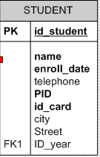
Well done !!!
You’ve created Table model for STUDENT.
Id_student PK, numeric(9), Mandatory name: text(50), not null …. Id_year: FK from YEAR, numeric(9), mandatory

Slide 25
Ass. 3
Make table model for COURSE
Create entity-table for COURSE

Slide 26

Table model for m-n relation
Whenever there is an m-n relation between two entities, it is represented with NEW INTERSECTION Table, that describes this relation
This table must have at least one attribute, primary key.
It can have other attributes that describe the relation.
The Name of the table is either same as the relation or it is an acronym got from the names of the related tables.
Пр. Enroll, COURSE_STUD

Slide 27
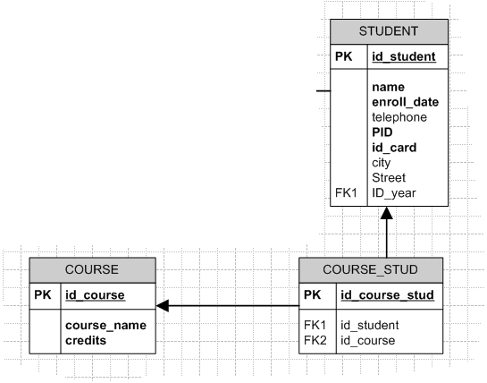
Relations: STUDENT 1–n COURSE_STUD and COURSE 1–n COURSE_STUD
STUDENT
n
enrolls
m
course

Slide 28
Questions for homework
Which STUDENT attribute is represented with course_stud attribute, id_student? Explain what does it mean.
Which COURSE attribute is represented with course_stud attribute, id_course? Explain what does it mean.
What is the cardinality of Student – course_stud relation and Course – course_stud relation ?

Slide 29
